Slide 1
Innovation and Adaptation in the Development of Standards for Absorbable Implants.
Byron Hayes
Biomaterials Research and Development
W.L. Gore & Associates, Inc.
Flagstaff, Arizona US

Slide 2
Disclosures
Full time employee W.L. Gore & Assc.
34 year employee; working w/ absorbable materials/implants since 1980s
ISO (International Standards Organization)
Convener: ISO-TC150/SC2/WG7 (Cardiovascular Absorbable Implants)
Convener: ISO-TC150/WG13 (Absorbable Metal Implants)
Liaison ISO TC150 - TC194
ISO Delegate status via ANSI/AAMI
ASTM-International
Co-Chair - ASTM F04.90.02 Subcommittee on Absorbable Metals
Chair - ASTM F04.97 Editorial & Terminology Subcommittee
Co-Chair - ASTM F04.11.05 Absorbable Polymers Task Group
Participant: F04.30 Cardiovascular Absorbables Task Group

Slide 3
Presentation Overview
Introduction
Evolving role for standards
Absorbable (metals) technology (briefly)
Absorbable Related Standards
A story of a inter-SDO journey
Absorbable metal standards under development (today)
Notes:
Enter speaker notes here.

Slide 4
Presentation Overview
Introduction
Evolving role for standards
Absorbable (metals) technology (briefly)
Absorbable Related Standards
A story of a inter-SDO journey
Absorbable metal standards under development (today)
Notes:
Enter speaker notes here.

Slide 5
Introduction - Potential evolving role for standards
Typical for today’s upcoming technologies:
Often are complex
Often technical uncertainties, with confusing/confounding issues
Often encounter shortages of expertise
Can be regional or global in nature
In such technologies, value exists for guidance/consensus regarding what is truly important for the proper assessment of evolving new products
Valued by: researchers, process/product developers, regulators
Especially in medical industry where development costs are upfront and high
Opportunity for standards development processes to adapt to better engage a likely limited pool of difficult-to-access expertise.
Notes:
"In a future of complex and potentially confusing technologies where demand for expertise is great, supply is limited, and many technical uncertainties exist, standards development processes need to adapt to engage a likely limited pool of difficult-to-access expertise.
Examples costs: Drugs, Abbott Vascular ABSORB stent >$1B before the first $ in return

Slide 6
Presentation Overview
Introduction
Evolving role for standards
Absorbable (metals) technology (briefly)
Absorbable Related Standards
A story of a inter-SDO journey
Absorbable metal standards under development (today)
Notes:
Enter speaker notes here.

Slide 7
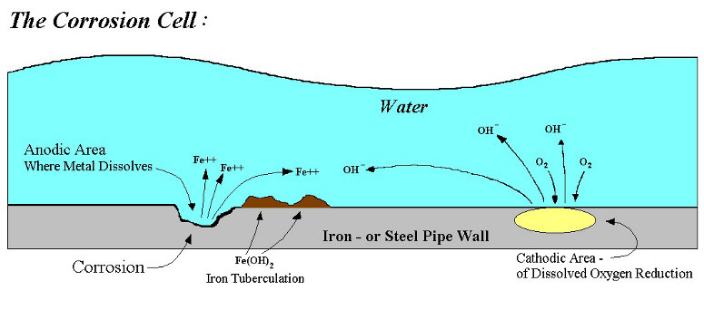
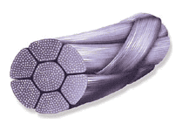
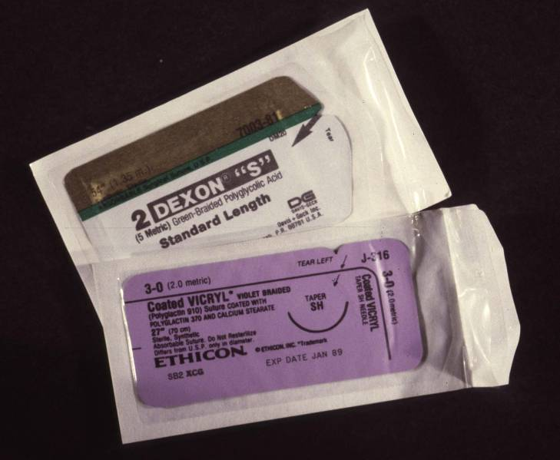
Introduction - Absorbable implant technology
Synthetic absorbable polymers
Sutures commercially available since the 1970s
Large molecules (polymer chains) that slowly break up and become smaller naturally occurring molecules when exposed to the body’s moisture (via hydrolysis)
In general, predictable bulk degradation throughout
Multiple ISO, ASTM, USP, Eur. Pharm. standards to date
Absorbable metals (Mg, Fe, Zn)
Fundamentally different
Base metal corrosion process occurs via an atomic level surface interaction with a surrounding solution
The generated ions and other degradation products are dependent on the composition of both the metal and the solution (or the body)
No relevant standards prior to this effort
Source: http://www.engineeredwater.us/corrosion_control
Notes:
These same alpha-hydroxyl ester polymers have led to the absorbable stents that are now appearing on the market today.

Slide 8
Introduction - Absorbable (metals) technology
Corrosion
From almost the start of time, corrosion research has been focused on its prevention
Historically little incentive toward understanding the complexities of the advanced stages of corrosion and its management
Incentive for permanent implants is to avoid corrosion, with focus on prevention
Intentional in vivo corrosion is a relatively new concept
Implant in a warm salt environment
Needs to deliver mechanical attributes and then go away,
Not too quick, not too slow
Needs to not damage the patient or surround tissue
Inflammation / premature fracture

Slide 9
Introduction - Absorbable (metals) technology
Corrosion
Effectively unravels the entire processing history of the metal
Composition (e.g. alloying elements, trace elements)
Physical/thermal history/condition (e.g. casting, forging, annealing, grain size)
Surface Treatments (e.g. oxide layer formation)
Coatings (e.g. drug release matrix)
Added In vivo factors
Body’s electrolytes and proteins
Difficult to impossible to model in the lab (in vitro)
Expected (cyclic, static) loading (within a corrosive environment)

Slide 10
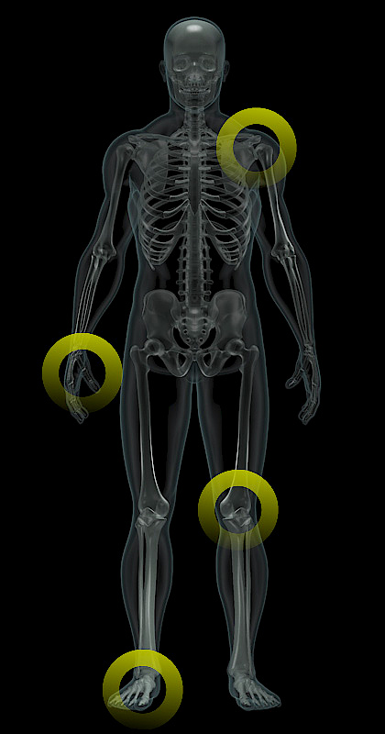
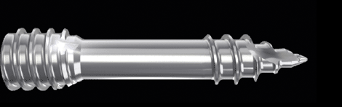
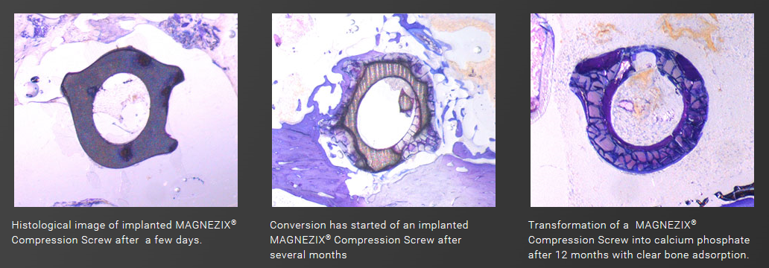
Absorbable Metals - Commercialized Products -
CE Mark (EU Market approved)
Syntellix MAGNEZIX® (Mg compression screw)
http://www.syntellix.de/en/syntellix/
Notes:
Future is here:

Slide 11
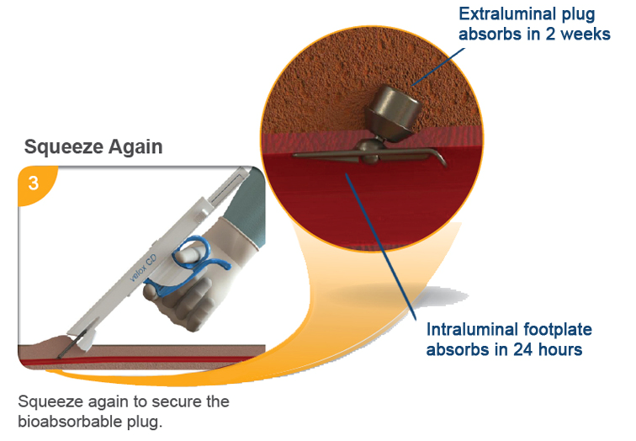

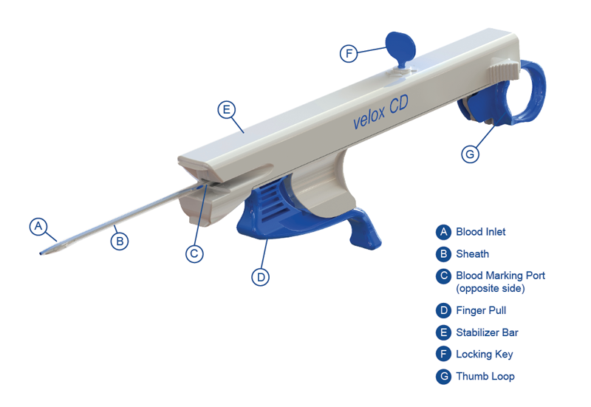
Absorbable Metals - Commercialized Products -
CE Mark (EU Market approved)
velox CDTM (Mg vascular closure device)
Transluminal Technologies
http://www.transluminal.net/
Notes:
Future is here:

Slide 12
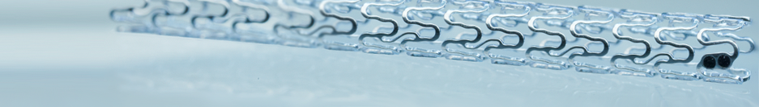
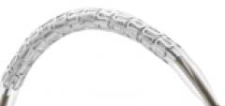

Absorbable Metals - Upcoming (“on deck”) Products -
Biotronik (Mg coronary stent)
Conclusion BIOSOLVE-II clinical trial (TCT 2015; 10/2015);
Design Dossier for CE Mark submitted
Source: Haude (TCT 2015)

Slide 13
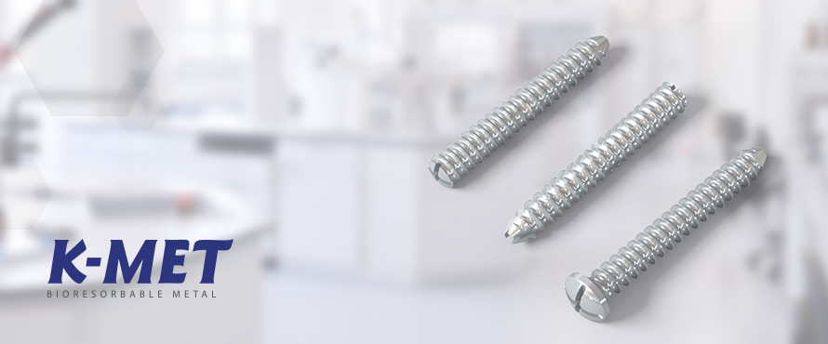
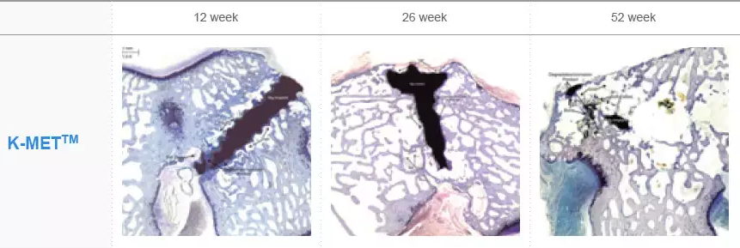
Absorbable Metals - Upcoming (“on deck”) Products -
U&I (Korea) K-METTM (Pedicle Bone Screw)
Mg-Ca alloy
http://www.k-met.com/en/?c=kmet
Clinicals
https://clinicaltrials.gov/ct2/show/NCT02456415

Slide 14
Introduction - Absorbable (metals) technology
Valuable but Complex Technology
Devices that absorb allow the body to return to its natural condition, removing the potential for ongoing inflammation and mechanical irritation and/or failure
Examples: stents - return to pulsatility; bone – natural remodeling/strengthening
Polymers will never provide the dimensionally proportional strength that metals have to offer
The more complexity, the high value for standards
Be it aerospace, computer interface protocols, or medical implants
The more complex a technology, the more need for coordination of variables, the more need (and value) for standards

Slide 15
Presentation Overview
Introduction
Evolving role for standards
Absorbable (metals) technology (briefly)
Absorbable Related Standards
A story of a inter-SDO journey
Absorbable metal standards under development (today)
Notes:
Enter speaker notes here.

Slide 16
Absorbable Metals Related Standards - A practical need - TC150/SC2/WG7 Activities
ISO TC150/SC2/WG7 - Cardiovascular Absorbable Implants
TC150 = Implants for Surgery
SC2 = Cardiovascular Implants and Extracorporeal Systems
WG7 = Cardiovascular Absorbable Impregukar lants
Focus: Absorbable Stents
Polymeric - Abbott Vascular (US) and many others
Metallic (Magnesium) - Biotronic (Germany)
Regulators – US-FDA, Brasil ANVISA, others
Standardization theme: what needed for absorbables beyond basic performance already required for permanent implants
Many ASTM & ISO cardiovascular implant/stent standards already exist

Slide 17

Current Absorbable Standards - Device/Application Specific (Cardiovascular) -
ISO/TS 17137 - Cardiovascular implants and extracorporeal systems − Cardiovascular absorbable implants
The guide covers absorbable related:
Design Evaluation Requirements
in vitro Acute Assessment
in vitro Chronic Assessment
in vitro/in vivo Correlation
Biocompatibility
Preclinical in vivo Evaluation
Clinical Evaluation
Shelf-life Considerations
Drug-Absorbable Component Interactions

Slide 18
Current Absorbable Standards - Device/Application Specific (Cardiovascular) -
TS17137 - Absorbable Metal Specific Provisions:
General considerations (e.g. grain size)
MRI compatibility (when gone and safe)
Permanent corrosion challenge tests that made no sense for intentionally corrodible (ASTM F2129)
No correlation between in vitro and in vivo
Places the emphasis on in vivo evaluations
Static Cell culture Biocompatibility tests (ISO 10993) fail when corrosion products
Adjust pH and osmolality (as happens in the body)
Numerous changes from standard evaluation methods
Developed Annex w/ specific list of changes to 10993 series

Slide 19
Current Absorbable Standards - Additional Offshoot Efforts -
Integrated guidance to efficiently link with existing standards
ASTM F3036-13 Standard Guide for Testing Absorbable Stents
Describes absorbable-specific considerations when evaluating stents for:
F2606-08 THREE-POINT BENDING
F2079-09 INTRINSIC ELASTIC RECOIL
F2394-07 SECUREMENT OF MOUNTED BALLOON-EXPANDABLE STENTS
Document designed to be updated as new standards are approved
Approached ISO TC194 (Biological and Clinical Evaluation) to review Annex
Wanted critical review by global quality expertise
TC194 realized value of compilation was not specific to cardiovascular, could be applied to orthopedic and any other absorbable metal implant application
Included both absorbable polymer and metal provisions
Conclusion: TC194 wanted Annex as own stand alone document

Slide 20
Current Absorbable Standards - Biological Evaluation Specific -
ISO/TR 37137 (Published) - Biological evaluation of medical devices — Guidance for absorbable implants
Applicable to all absorbable implants (polymers & metals)
Follows a standards integration theme that identifies absorbable-related adjustments to specific existing standards.
TR approach provides interim guidance and advances understanding of the technology while already established 10993 standards can later be caught up at systematic review!

Slide 21
Significant ISO/TR 37137 absorbable metals related language
Features
Adjustable evaluation periods based on degradation rather than existing rigid evaluation periods for permanent implants
Adjust cell culture pH and/or osmolality to bring the cell culture into a physiologic range –
The body is in a continual flow environment that help to maintain pH and dilutes high concentrations
Cell cultures have limited to no flow/replenishment
Good general guidance, but need persisted toward more specific guidance and methods, in all absorbable metal related areas.

Slide 22
Presentation Overview
Introduction
Evolving role for standards
Absorbable (metals) technology (briefly)
Absorbable Related Standards
A story of a inter-SDO journey
Absorbable metal standards under development (today)
Notes:
Enter speaker notes here.

Slide 23
Absorbable Metal Standards - currently under development -
Recognized need for additional guidance in other fields beside Biological Evaluation
In late 2013, need for specific absorbable metal (AbsMet) standards was being recognized in both EU and US
ASTM facilitated a conference call level exploration regarding need for AbsMet standards and presence of adequate expertise (Jan. 2014)
Noted enough “critical mass” of AbsMet expertise in ASTM F04 to initiate standards development
Developed into an ASTM administrative web site (AC87) along w/ regular 4 hour meetings twice annually at ASTM F04 Committee week meetings (May/November)
Group identified need for 5 separate standards, all of which are now progressing
Group initiates AbsMet standards that are then formalized within the appropriate SDO and related committee
Notes:
Toward that end, an impromptu model evolved that actively promotes a cooperative development of standards with professional societies as well as with other technical committees and/or standards development organizations. Aimed at standards for absorbable metals (for implants that intentionally degrade in the body), the effort seeks to provide guidance not only to product developers and regulators, but also to fundamental researchers.

Slide 24

Absorbable Metal Standards - currently under development -
ISO/TS 20721 Implants for surgery — Standard guide to assessment of absorbable metallic implants
ASTM F3160 (WK46455) - Standard Guide for Metallurgical Characterization of Absorbable Metallic Materials for Medical Implants
ASTM WK52640 - Guide to in vitro Degradation Testing of Absorbable Metals
(ASTM) Guide to Corrosion Fatigue Evaluation of Absorbable Metals
(ISO TC194) - Guide for the Biological Evaluation of Absorbable Metals
“Materials” Document
“Umbrella” Document
“Degradation” Document
“Fatigue” Document
“Bio Eval” Document
Notes:
Standards being actively coordinated and harmonized to prevent conflicts and duplication.

Slide 25
Absorbable Metal Standards - currently under development -
Active “AC87” participation now involves two ISO Technical committees and 1 professional society
ISO TC150 (Implants for Surgery)
TC194 (Biological and Clinical Evaluation)
ASTM Committee F04 (Medical & Surgical Devices)
Biodegradable Metals Symposium (BioMetals)
Top researchers and global thought leaders with appreciation for the value of standardization within the field.
Hosts discussion of drafts at annual conference; comments addressed/integrated
Participants from multiple countries
Total AC87 subscribers ~75
Korea/Japan/China to Europe to US/Brasil
Provides online access for early review & feedback
Notes:
“… It has now evolved into a cooperative ISO-ASTM effort that seeks and actively engages relevant academic and commercial expertise from both within and outside the normal standards development processes – an approach facilitated by online discussion resources and special review sessions at strategically selected meetings and conferences.“
Researchers were asking for standards to encourage better reporting and investigation consistency.
Sufficient need to host standards development sessions at conference.

Slide 26
Absorbable Metal Standards - currently under development -
ISO/TS 20721 - Standard guide to assessment of absorbable metallic implants
F04.90.02 (AC87) “Umbrella” Doc 1
Ties together other 4 documents
Formally organized under ISO TC150 WG13
Initiated via ASTM AC87 activities
Umbrella ties documents into a coherent presentation and encourages harmonization / minimization of duplication
ISO status brings broadened international recognition to individual (including otherwise independent) standards
TC150 Committee (CD) level review expected by end of 2016.

Slide 27
Absorbable Metal Standards - currently under development –
ASTM WK46455 – Standard Guide for Metallurgical Characterization of Absorbable Metallic Materials for Medical Implants
F04.90.02 (AC87) “Materials” Doc 2
Committee level balloted under main ASTM Committee F04
Publication expected in 2016

Slide 28
Absorbable Metal Standards - currently under development –
ASTM WK52640 - Guide to in vitro Degradation Testing of Absorbable Metals
F04.90.02 (AC87) “Degradation” Doc 3
Many complex factors; will require most deliberation/engagement during development
Formally balloting under ASTM F04.15 Subcommittee on Materials Test Methods
Further refinement; expect final approval/publication in 2017

Slide 29
Absorbable Metal Standards - currently under development –
(ASTM) – Guide to Corrosion Fatigue Evaluation of Absorbable Metals
F04.90.02 (AC87) “Fatigue” Doc 4
Early formative development
In depth development to follow current Doc 3 (in vitro Degradation Testing)

Slide 30
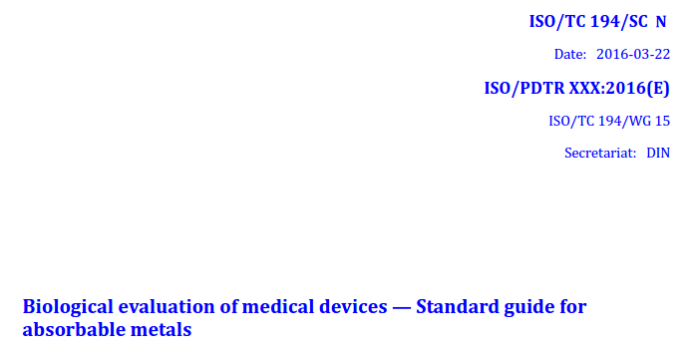
Absorbable Metal Standards - currently under development –
(ISO TC194) – Biological evaluation of medical devices - Standard Guide for Absorbable Metals
F04.90.02 “Biological Evaluation” Doc 5
Currently under ballot as a new work item proposal under ISO/TC 194 - Working Group 15 – Strategy (impacts/affects numerous 10993 standards)
Requires 5 different countries to provide experts

Slide 31
Absorbable Metals Standardization - Collaboration/Cooperation Overview -
ISO
TC150/WG13 – Absorbable Metal Implants
TC194/WG15 – Biological Evaluation - Strategy
ASTM Committee F04
Subcommittee F04.12 – Metallic Materials
Subcommittee F04.15 – Material Test Methods
Subcommittee F04.90.02 – Absorbable Metal Related Discussions
ASTM AC87 Collaboration Site
Biodegradable Metals Symposium (BIOMETALS)
Professional organization w/ most knowledge of technology
Likes standards and consensus; dislikes development timelines

Slide 32
Absorbable Metals Standardization It is happening!
Consensus Goal:
Define what is truly important and how best to measure it.
Direct formal involvement in via respective SDO
ISO TC150 – in US, via ASTM
ISO TC194 – in US, via AAMI
ASTM Committee F04 - via astm.org
Indirect involvement through ASTM AC87 on-line Collaboration Area for F04.90.02
Provides bridge to those with interest, but w/ limited time to commit
Supplements expertise beyond that within SDO or TC
Many alternate review/feedback options (Yahoo Groups, etc.)
No ASTM membership required to participate (only need invitation)
For access, contact: Byron Hayes bhayes@wlgore.com

Slide 33
END
Thank you for your time and interest.

